Slide 1

YOUR CAR FINDER
Anthony Okoli
Finlay Mackenzie
Martin Meszaros

Slide 2
Introduction
Challenge
Adam in the challenge wants to buy his first car
He doesn’t have enough money, so he is looking for the most cost-effective option on the market
The problem Adam has might seem small but can be overwhelming and exhausting

Slide 3
Our Solution
Delivered on key outcomes
Met base outcome – Calculated TCO cost of Adam’s car with fixed values
Met advanced outcome – Calculated TCO and best choice with user’s own budget and estimated milage
Met supplementary outcome – User review score of 1-5 implemented as a weight in the heuristic

Slide 4


Tool and library choices
Python
Python libraries: Pandas and numpy
Jupyter notebooks
VScode
Git version control

Slide 5
Data Pre-processing
Key steps needed in advance of the model

Slide 6


Centralizing manufacturers’ CSV records
Combined into one CSV for easier
Processing
Added ‘make’ as new column amended to all entires based on the file name.

Slide 7
Sanitizing central CSV
- Verified unique column names, unique

Slide 8
Finding closest-matching car model

Slide 9
Sanitizing , extracting and merging car maintenance and reviews

Slide 10
Main solution and approach
Solved with a combination of machine learning fuzzy search and secondary weighted heuristic
Initially preforms a ‘fuzzy search’ to filter the main set down to best suited 100 then refines

Slide 11
Heuristic in depth
Considerations and custom weighting for heuristic

Slide 12
Justifying methods and approach
Why fuzzy search over others? (consideration with neuro networks)
Why refine top 100 entries with finetuned heuristic?

Slide 13
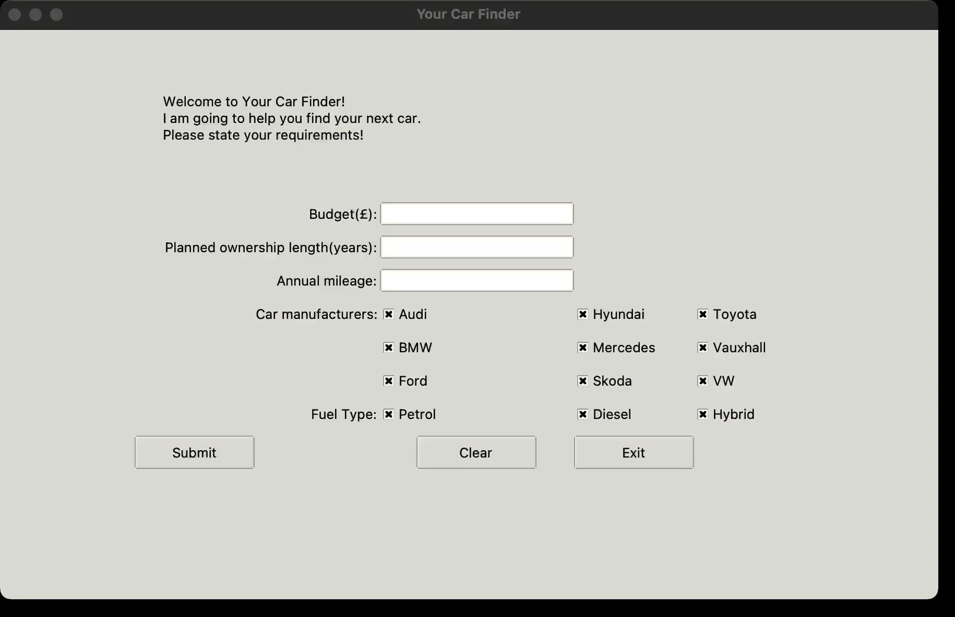
Demo of project working

Slide 14
Further development and next steps
Utilize the built interface layer on the heuristic weight. Existing infrastructure build in which allows for custom scenarios unique to the user’s needs:
May live in an ULEZ zone adjusting a serious penalty to the emissions and fuel-type weightings.
User may have low starting budget (for initial cost) but can afford higher maintenance in the long term

Slide 15
Further development and next steps
Utilize the built interface layer on the heuristic weight

Slide 16
Further development and next steps
Deppriciation calculator using historic data.
Will predict what the resale value of the car will be post-ownership cycle based on existing records. Can cross-reference with existing available API (such as Autotrader) to combine this estimate with current / former listings with familiarity to chosen car

Slide 17
Further development and next steps
External data on major product recalls / reported known issues with the car model. (Cost may be deceiving if vehicle has a manufacturer recall or safety fault known.

